Slide 1
Four-year trajectories of forest subcanopy response to disturbance: Scaling leaf function to ecosystem production stability
Lisa T. Haber
PhD candidate
Integrative Life Sciences doctoral program
Virginia Commonwealth University

Slide 2
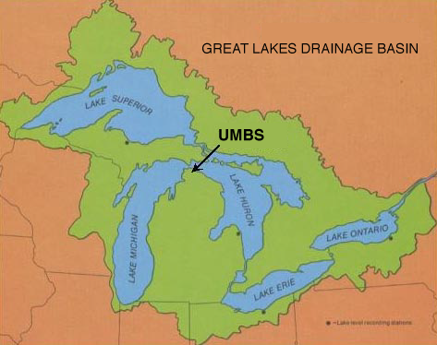
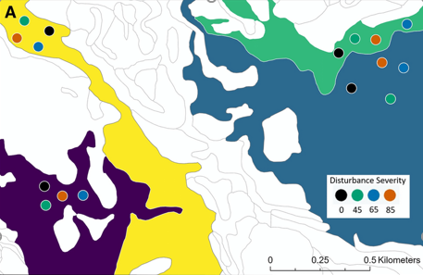
Forest Resilience Threshold Experiment (FoRTE)
3700 stems, 8 ha., May 2019

Slide 3
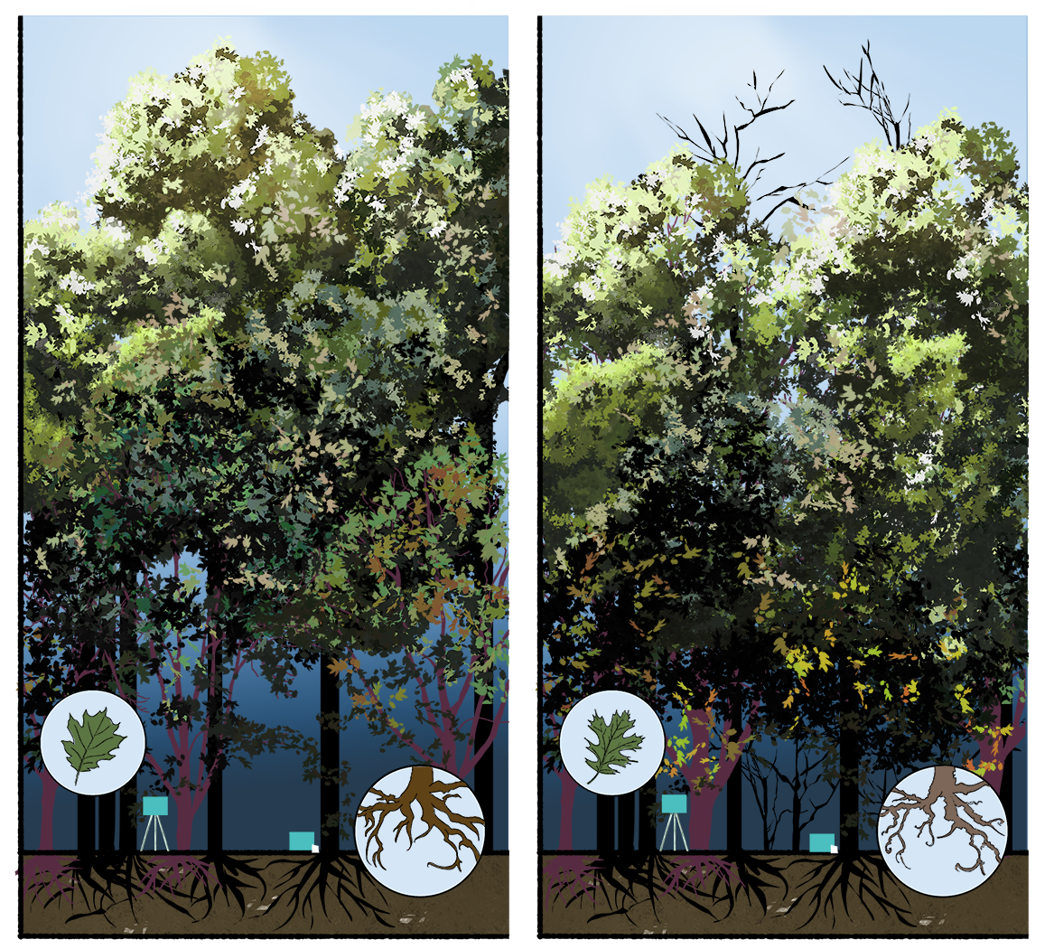
SUNLIGHT
Image credit: Erika Masis Laverde, VCUarts

Slide 4
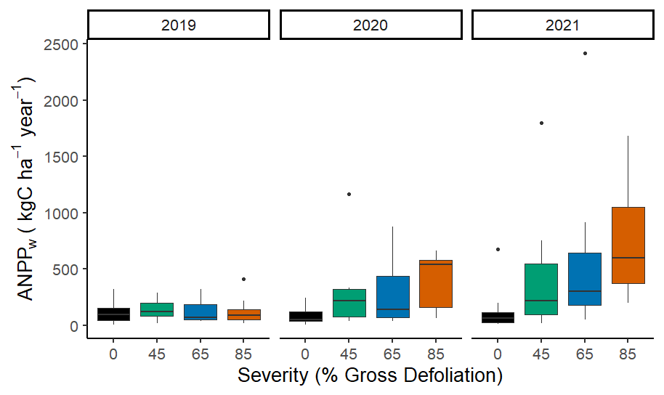
Subcanopy NPP
* p < 0.05
*
*
*
*
*
*

Slide 5
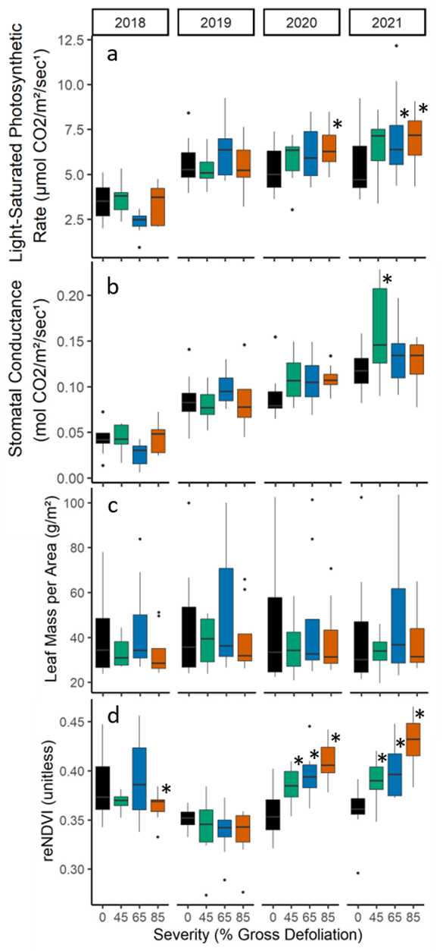
Which subcanopy leaf functional traits respond to rising disturbance severity over time?
Which are useful for predicting this forest layer’s production after disturbance?

Slide 6
Stepwise model selection
Predictors | Adj. R² | F | p | AIC | AICc
A_{sat} g_{s} LMA reNDVI site | 0.235 | 5.18 | < 0.001 | 33.06 | 309.85
A_{sat} g_{s} reNDVI site | 0.244 | 6.11 | < 0.001 | 31.33 | 307.42
A_{sat} reNDVI site | 0.250 | 7.34 | < 0.001 | 29.61 | 305.32
reNDVI site | 0.254 | 9.09 | < 0.001 | 28.18 | 303.56

Slide 7
Key take-aways
Stimulated subcanopy NPP is an important stabilizer of forest C cycling following disturbance
Even up to 85% tree loss!
Leaf traits can predict ecosystem-scale C cycling
Though highly related, some leaf traits are more useful than others for predicting forest C uptake after disturbance
Good news!

Slide 8



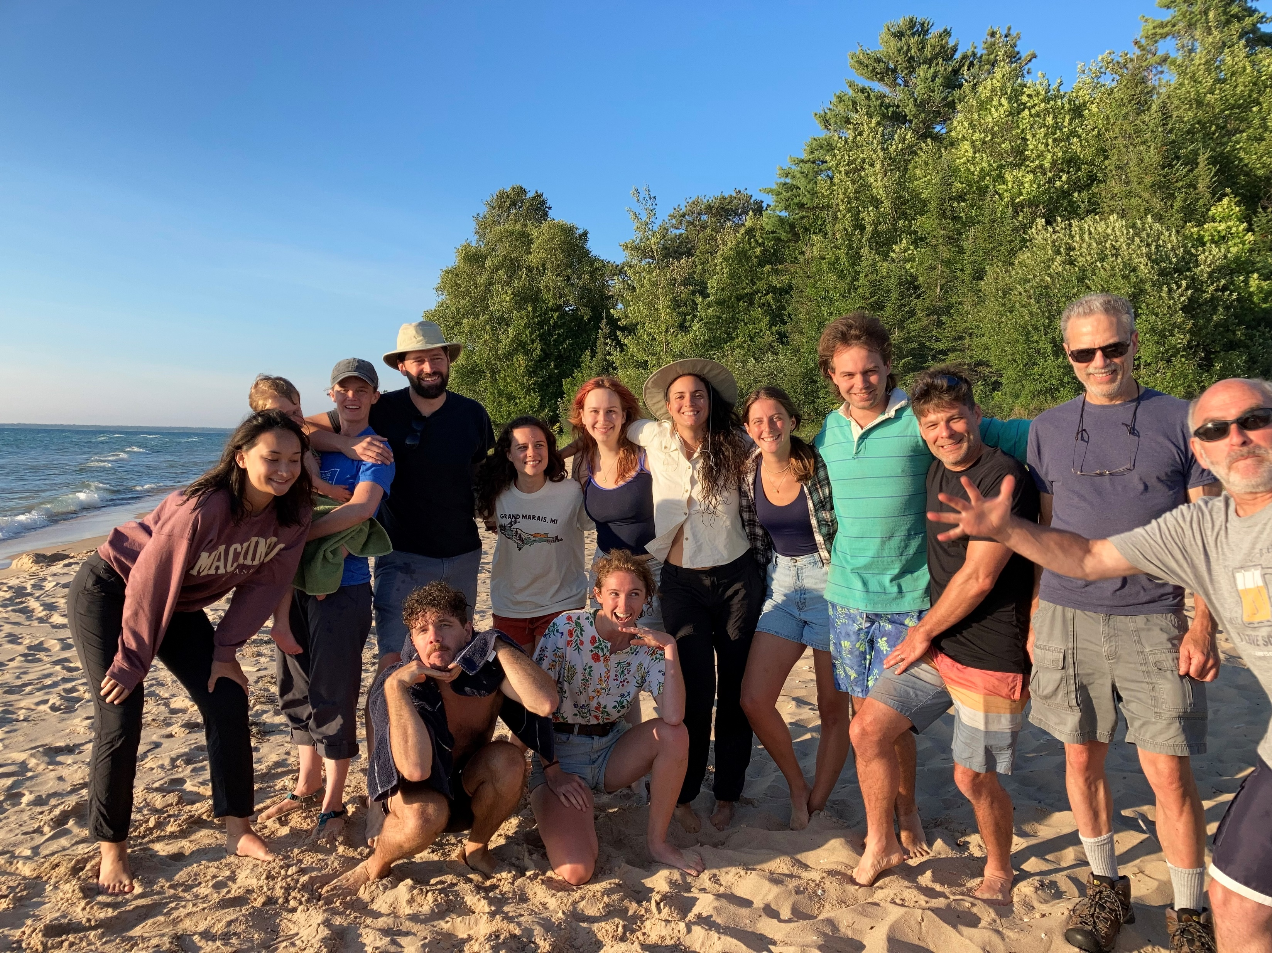
Acknowledgements
FoRTE is supported by the National Science Foundation…
(DEB Award 1655095)
…the University of Michigan Biological Station…
…and VCU’s ILS program.
Thank you!

Slide 9
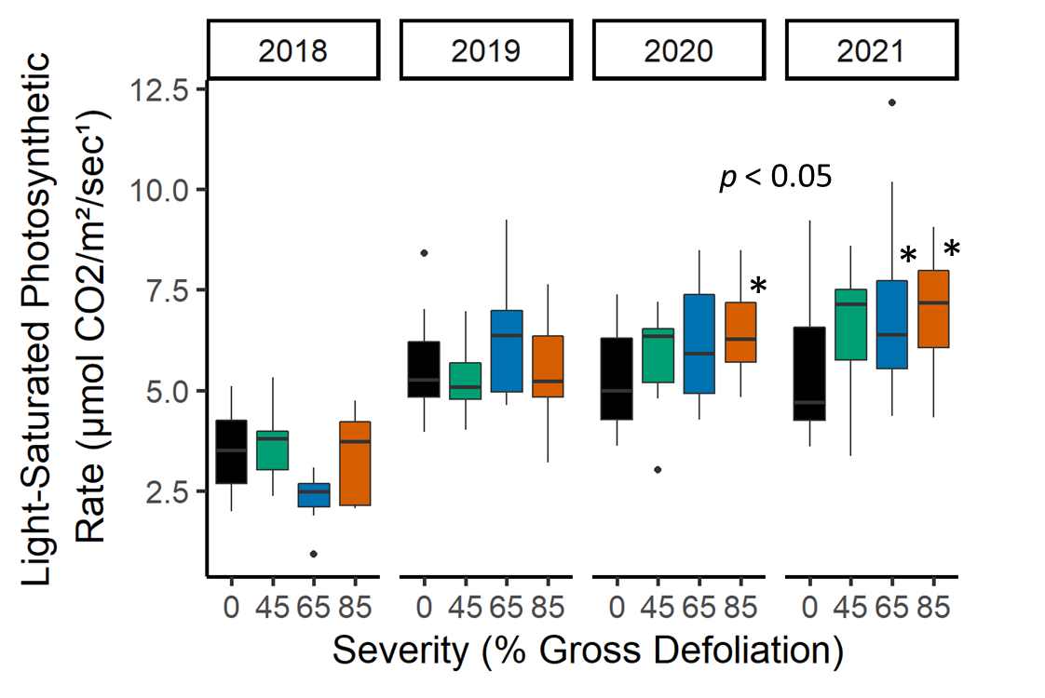
Leaf photosynthetic rate

Slide 10
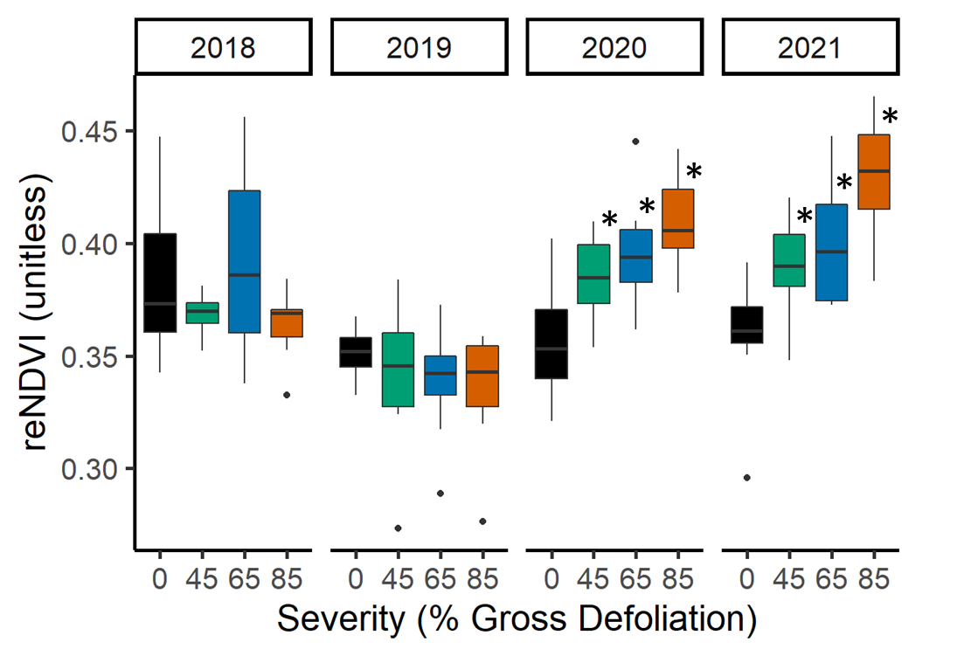
Leaf chlorophyll content

Slide 11
Key Preliminary Take-aways
Belowground…
R_{s} declines immediately and remains suppressed in 3 years following disturbance
Lower R_{s} is driven by declining R_{a}, not R_{h}, with rising disturbance severity
Aboveground…
Disintegration of closed canopy, and subsequent increases in subcanopy A_{sat}, lag initial disturbance via stem girdling
Implications for ecosystem C balance…
Rapid decline in R_{s} coupled with increased subcanopy NPP may stabilize NEP despite lost canopy area
Even at upper extreme of disturbance severity, ecosystem C balance may be sustained due to offsetting (though temporally lagged) above- and belowground responses

Slide 12
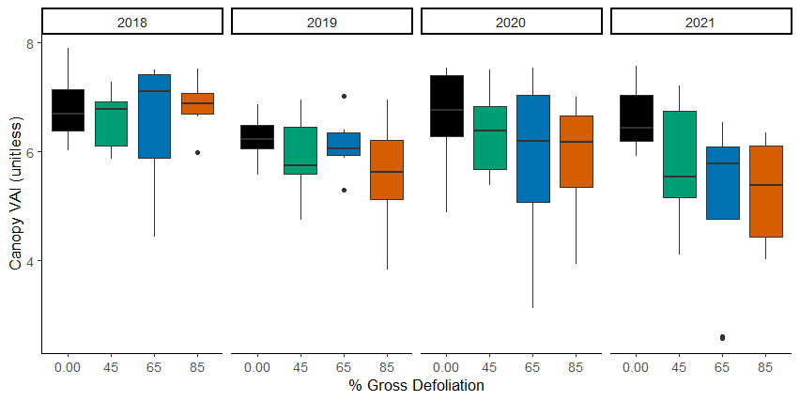
Canopy cover is lost…but only after 3 years
* p < 0.05, ** p < 0.01
*
**

